Slide 1
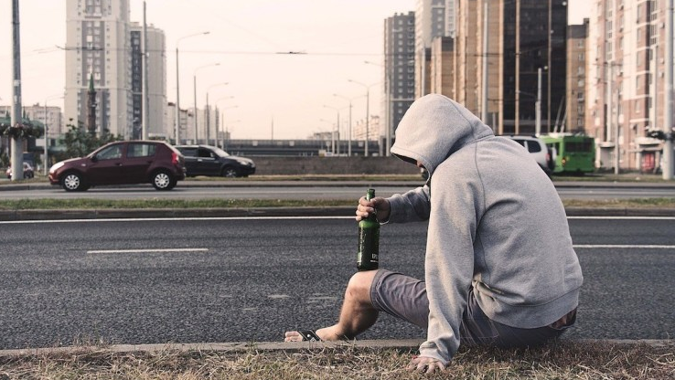

Los Angeles
Drinking x Crime
by
The Harmonious Hummingbirds
Andrew Wright
Jennie Chang
Leo Ramirez
Raymond Barry
Sanaz Shahbazian
Toshe Ayo-Ariyo

Slide 2
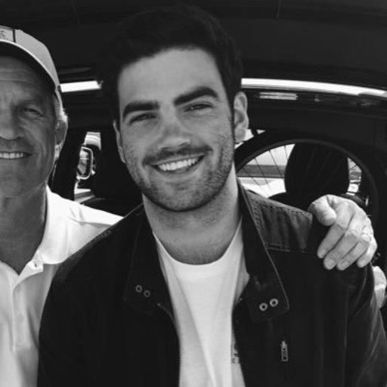

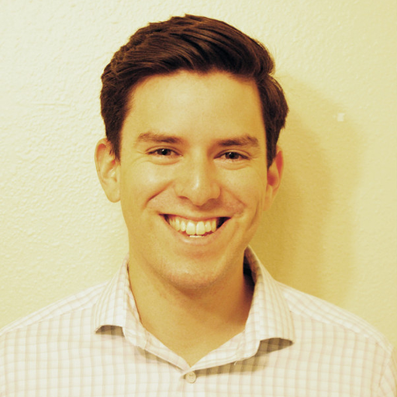

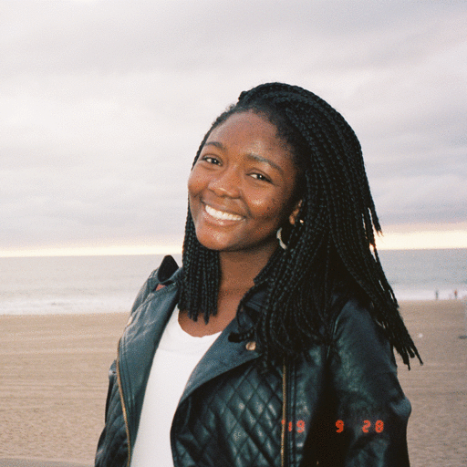


The Team
Andrew Wright
901 Bar & Grill
Jennie Chang
The Figueroa Hotel
Leo Ramirez
The Blind Donkey
Raymond Barry
Der Wolf
Toshe Ayo-Ariyo
Perch
Sanaz Shahbazian
71 above

Slide 3
Purpose
Determine if there is a correlation between bar popularity and frequency of intoxication related crimes
This analysis will eventually enable us to implement a crime rating on yelp

Slide 4
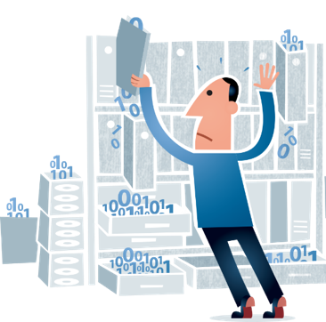

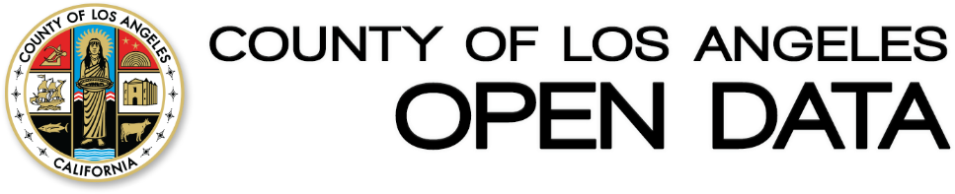
DATA
SOURCES
X
Los Angeles Crime API (2019)

Slide 5
Assumptions
The most reviewed bars are the most popular bars
Yelp and crime data only displays the city of Los Angeles
These crimes are a result of drinking alcohol at a bar within 2 miles of the crime location

Slide 6
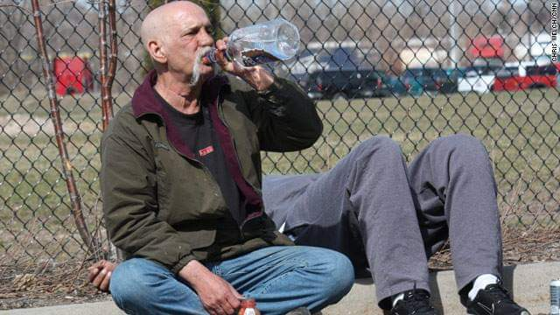
DEFINTION OF
Drunken Arrests
Crimes that include the following keywords:
Drunk
Drinking
Alcohol
DUI
Intoxication

Slide 7
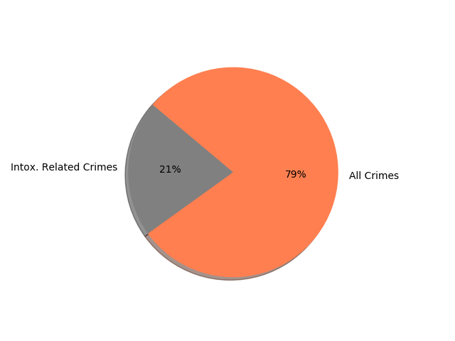
How does drunk-related arrests rank amongst different types of crime in LA?
While intoxication related crimes only comprise 21% of all crimes in LA, the top 2 types of crime are related to drinking
Top 5 Crimes:
Drunk driving (7.4%)
Drinking in public (7.0%)
Corporal injury on spouse/cohabitant (3.6%)
Possession of controlled substance (3.4%)
FTA after written promise (2.3%)

Slide 8
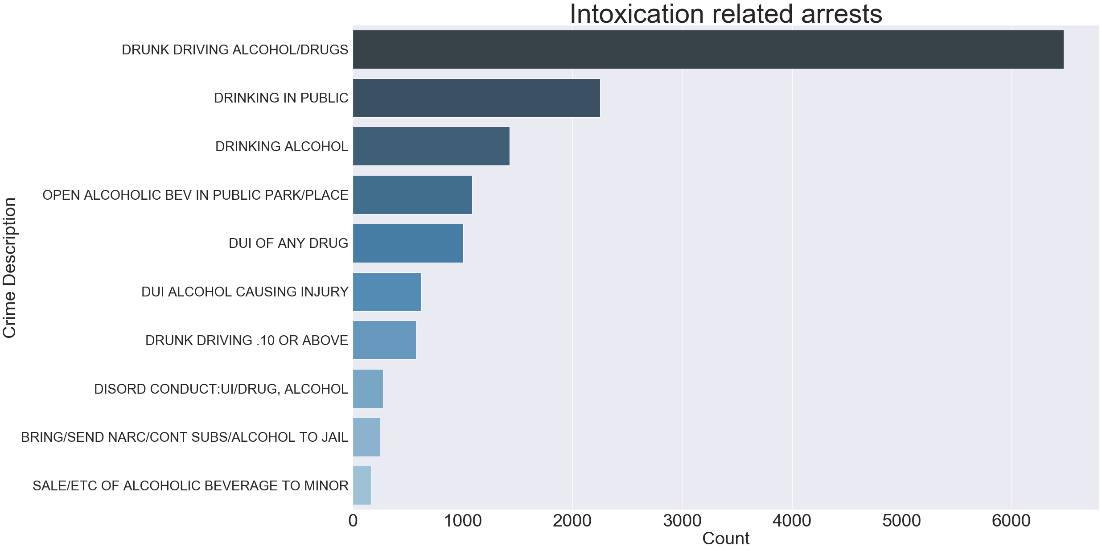
What intoxication related arrests are the most common?
43%
Drunk Driving and Drinking in Public are the two most frequent.which we can break it down as below:
drunk driving 43%
drinking in public 15%
The SALE/ETC OF ALCOHOLIC BEVERAGE TO MINOR is the least frequent type of crime
15%
15%

Slide 9
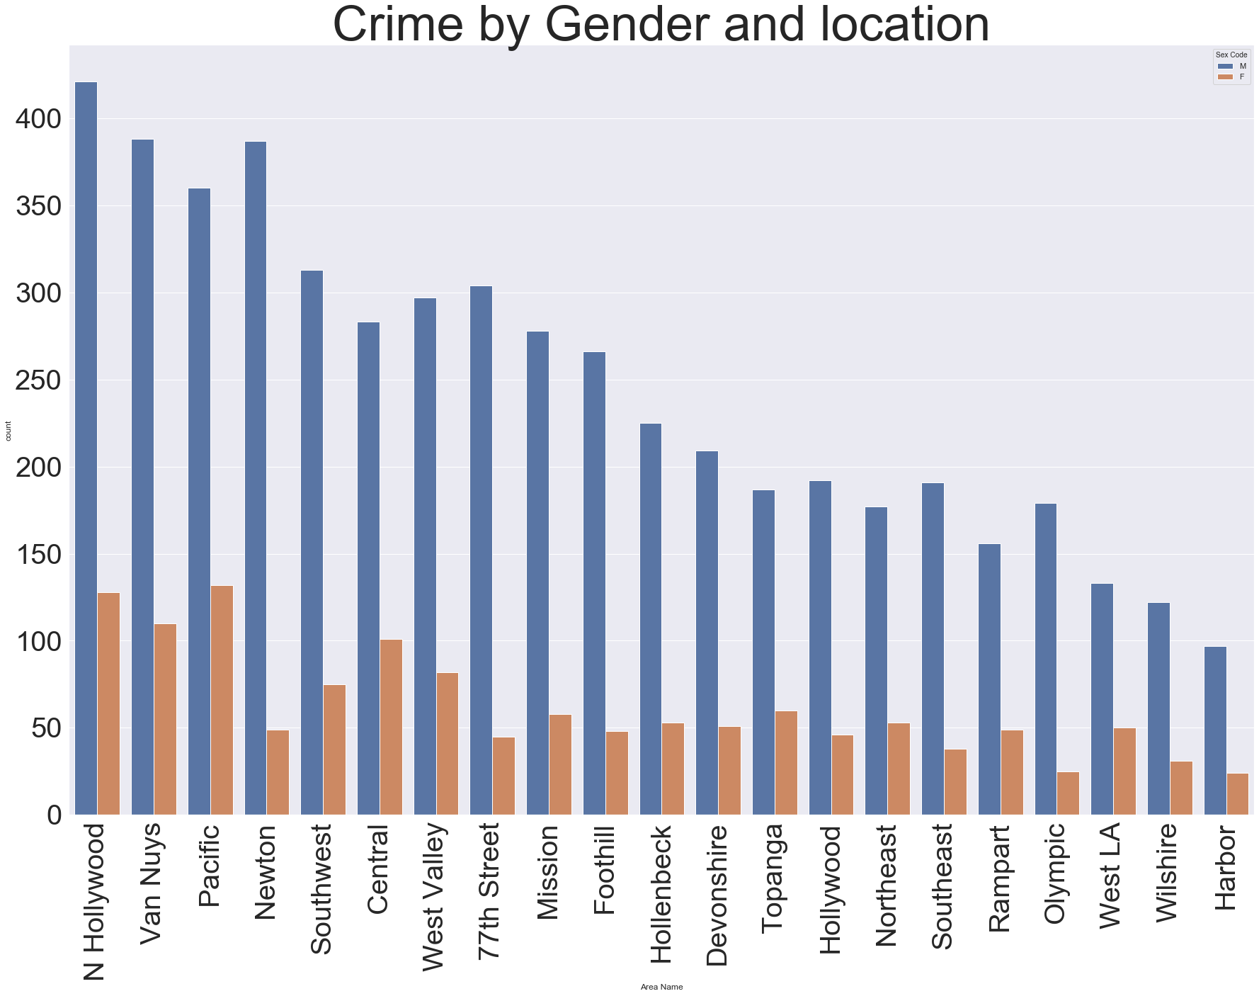
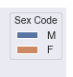
What gender is responsible for the majority of intoxication related crimes?
Females have committed less of these kind of crimes
(LA County population is 50% Male, 50% Female)

Slide 10
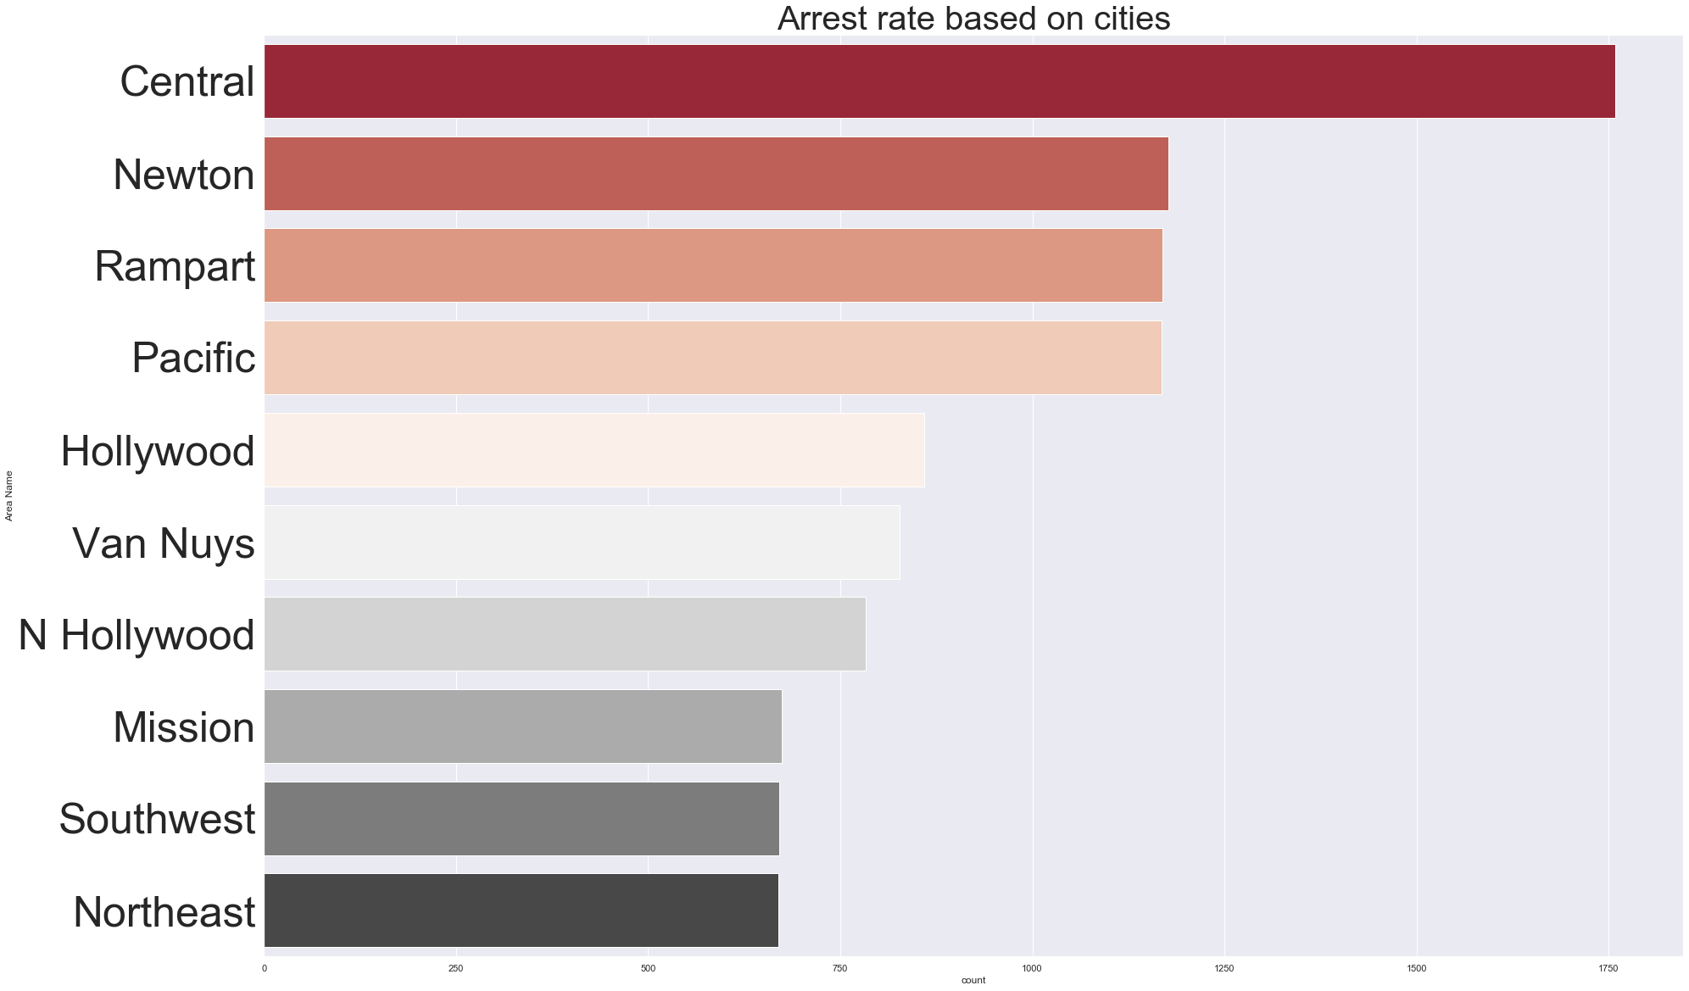
Where are the most arrests for public intoxication happening in LA?

Slide 11
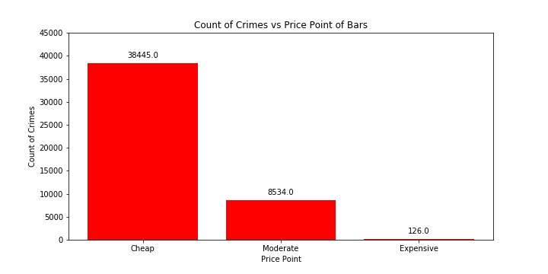
Are there more arrests around cheaper bars?
38,445
8,534
126
Notes:
Although this shows that cheap bars have the most crime around them, it doesn’t tell the whole story.
39 Cheap Bars, 9 Moderate Bars, 2 Expensive Bars

Slide 12
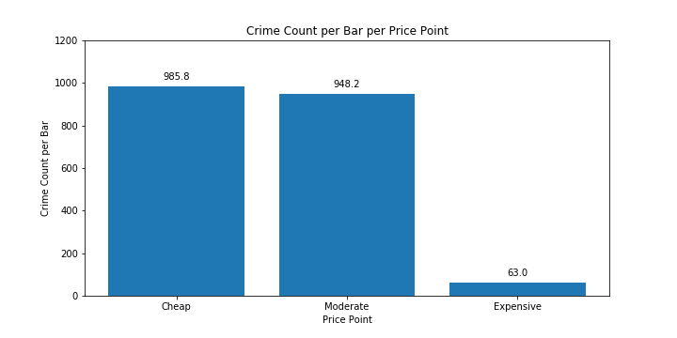
Are there more arrests around cheaper bars?
986
948
63
Notes:
Calculated the amount of crimes per bar per price point to normalize the values.
Showed that the moderate price point had just as many as crimes around them as cheap bars

Slide 13
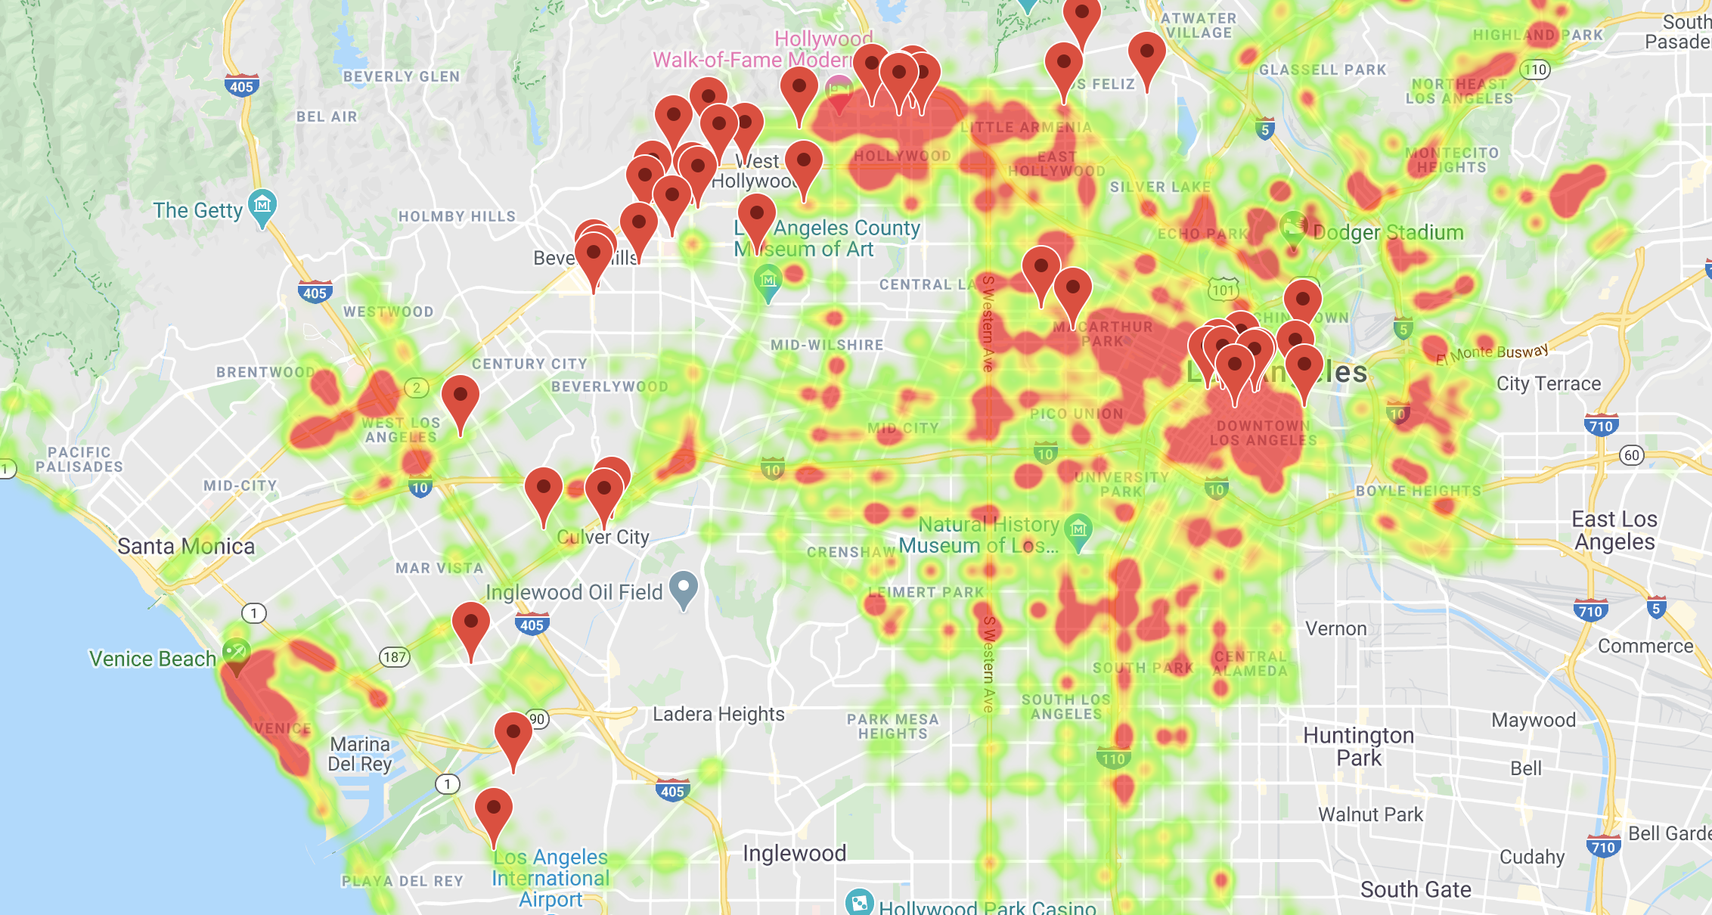
Concentration of drunken arrests in LA

Slide 14
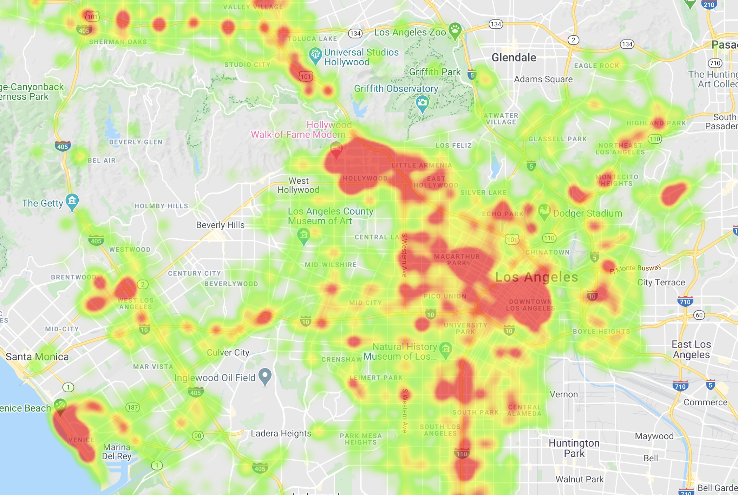
DUI Heatmap

Slide 15
KEY TAKEAWAYS
Drinking & driving is a serious problem in LA
Most drunk-related crimes are caused by men
Most drunk-related crimes happen near bars that are cheap or moderately priced
Pockets of central LA appears to be the safest with most DUIs occuring around freeways.

Slide 16
SO … BE SAFE!!!

Slide 17
APPENDIX

Slide 18
